Slide 1

Moving to the Unified Interface
SnapShot! for the POWER PLATFORM

Slide 2


Mitch Milam
mitch@xrmcoaches.com
@mitchmilam
linkedin.com/in/mitchmilam
youtube.com/xRMCoaches

Slide 3
Dynamics 365 Training
https://learn.xrmcoaches.com
Power Platform JavaScript Development
The Art and Science of Model-Driven App Design
50% off through the end of April use code: inthistogether at checkout

Slide 4
Getting Started

Slide 5
Previous Webinars
Eliminating Technical Debt
The Art and Science of Model-Driven App Design

Slide 6
Know Your Upgrade Date
https://runone.powerappsportals.com
After 1 December, 2020, all environments will be updated to Unified Interface

Slide 7
Prepare Your Environment
Make a copy of your Production environment into a Sandbox environment
Make sure the Solution Checker is installed
OR, Install and run the Solution Checker in your Production environment

Slide 8
Solution Checker
Client API (that means JavaScript)
Process Dialogs
Task Flows
Service Scheduling

Slide 9
Solution Checker
Must be run on a solution
Cannot be run on the Default Solution
Cannot be run on a Microsoft solution
Cannon be run on third-party solutions (managed)

Slide 10
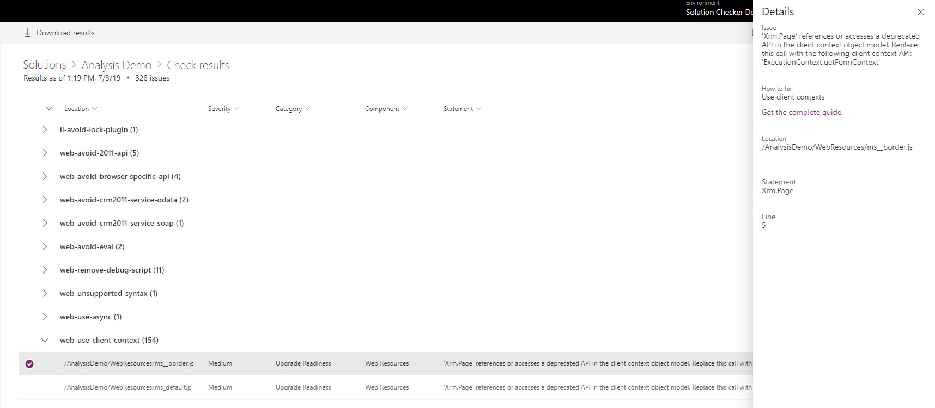
Solution Checker Results

Slide 11
Solution Checker
Review

Slide 12
Microsoft Guidance
Unified Interface Playbook

Slide 13
Unified Interface Playbook
Initiate
Explore
Transition
Optimize

Slide 14
Initiate
What is new and different in the Unified Interface?

Slide 15
Explore
Super Quick Test
Create a Parallel Test App
Create and Launch a Pilot App
Review and Follow-up

Slide 16
Transition
Determine the transition path
Understand compulsory changes
Rethink the user experience
Put the user first
Ensure methodology alignment

Slide 17
Optimize
Monitor, review, and innovate
Review experience
Future Release Cadence

Slide 18
Next Steps

Slide 19
Thinking Ahead
It may not be as scary as you think
It may also be more scary than you think
A lot will depend on the age of your system and the amount of changes made
NOW is the time to take action

Slide 20
Just Test It
In the Sandbox
Enable Unified Interface Only
Open the Dynamics 365 – Custom Application

Slide 21
Develop an Upgrade Strategy
JavaScript upgrade
Model-Driven App design
Third-party solutions

Slide 22
Model-Driven App design
Optimize navigation (SiteMap)
Update your icons to SVG
Review and update form layout
Add newer technologies

Slide 23
Testing
Lots and Lots of testing
Get the users involved

Slide 24
Case Study

Slide 25
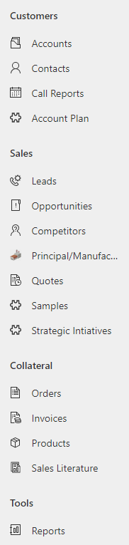
Case Study

Slide 26
Action Items
Restructure Navigation (SiteMap)
Align all entity form layouts and designs
Restructure forms for usability
Upgrade all JavaScript to the v9 model
Remove unnecessary third-party solutions and JavaScript

Slide 27
Questions?

Slide 28
Thank You

